Slide 1
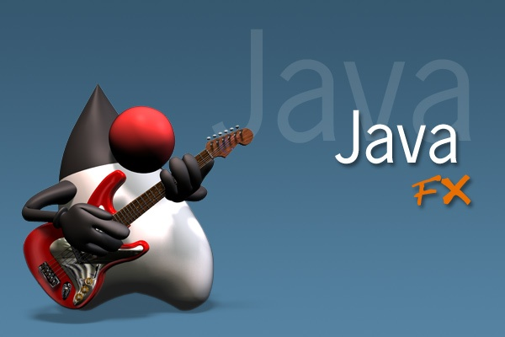

JavaFx
Dnes bude:
základné komponenty JavaFx (Node a podtriedy)
štýly (.css) a Scene Builder (.fxml)
spracovanie udalostí (myš, klávesnica, ...)
spôsoby návrhu jednoduchej (pravouhlej) hry
škálovateľnosť aplikácie
Zdroj a literatúra:
What Is JavaFX
JavaFX 2.0: Introduction by Example
Introduction to Java Programming, !!!!Tenth Edition
Cvičenia:
jednoduché aplikácie/hry s interakciou:
maľovátko, euro-kalkulačka,
logické (pravouhle) hry: pexeso, piškvorky, ...
Quadterm-2: dynamické hry, napr. tenis

Slide 2
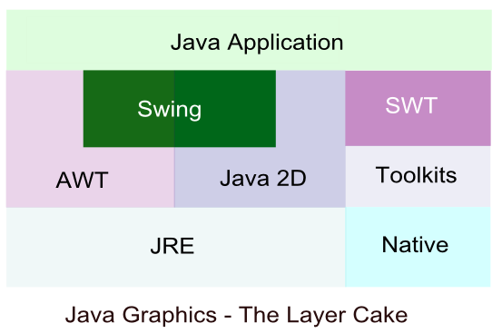
AWT-SWING
SWT-JavaFx
JAVA vznikla v r. 1995,
Java 1.1, 1997, integrovaný grafický balík AWT (Abstract Windows Toolkit),
Java 1.2, 1998, integrovaný grafický balík SWING,
od cca 2005, SWT (Standard Widget Toolkit), Eclipse Foundation, IBM
Java 1.7, 2012, integrovaný grafický balík JavaFx, pôvodný vývoj od 2007.
SWING (AWT):
je aktuálne mŕtvy, nevyvíja sa,
nie je multi-platformový,
je nepoužiteľný na mobilných zariadeniach,
je často pomerne ťažkopádny pre programátora (ale zvykli sme si…).
medzičasom vznikli a odzneli: Adobe Flash, Microsoft Silverlight, ...
preto sme tiež nahradili (dávno...) v prednáškach Swing a AWT platformou JavaFx

Slide 3

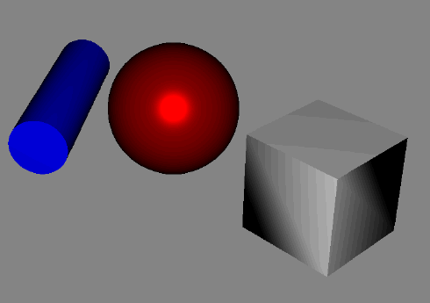
RIA
(Rich Internet application)
Cieľ: poskytnúť rovnakú funkcionalitu/vlastnosti web-aplikáciam ako poznáme z desktopových aplikácií
Najrozšírenejšie platformy: Adobe Flash, Microsoft Silverlight, JavaFx, HTML5/JS
JavaFx:
umožňuje spustiť lokálnu desktopovú aplikáciu v browseri, WebView,
podporuje:
  GUI štylizované pomocou CSS,
  multi-touch,
  multi-platform,
  SWING, komponent SwingNode 😐,
  2D a 3D grafiku, animácie,
  multi-média (audio, video),
nájdete ju inde, ScalaFx, Ruby, ...
Ako začať:
bezproblémová verzia eclipse (>= 4.4), java 1.8, a e(fx)clipse viac info tu:
https://www.eclipse.org/efxclipse/install.html

Slide 4
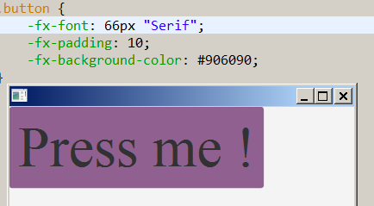
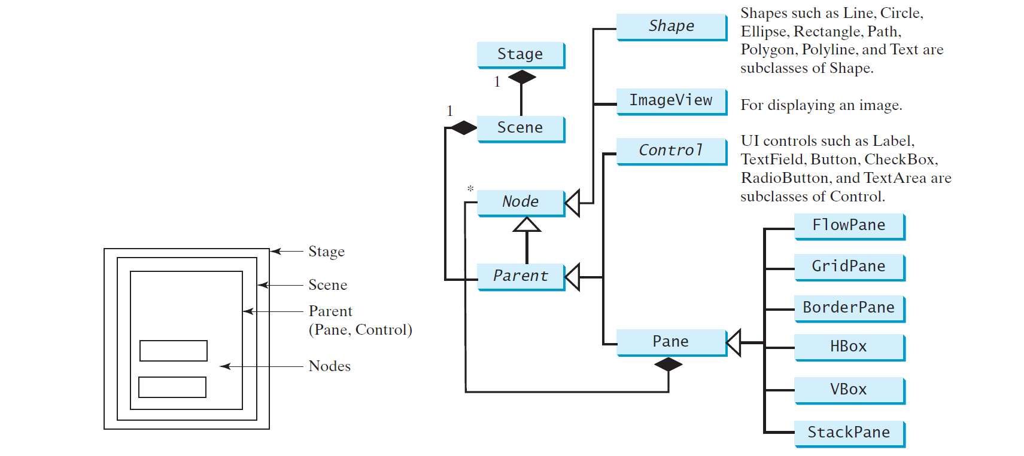
JavaFx aplikácia
public class Main extends Application {
@Override
public void start(Stage primaryStage) {
try {
Button btn = new Button(“Press me !“);
Pane root = new Pane(btn);
Scene scene = new Scene(root, 400, 400, Color.ORANGE);
scene.getStylesheets().add(getClass().getResource("application.css").toExternalForm());
primaryStage.setScene(scene);
primaryStage.show();
} catch(Exception e) {
e.printStackTrace();
}
}
public static void main(String[] args) {
launch(args);
} }
Súbor: SingleStageDemo.java

Slide 5
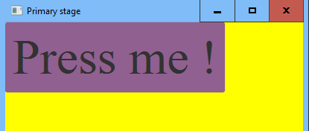
Node a štýl
Hint: Ak zobrazujete komponent, a nevidíte ho,
dajte mu žlté pozadie. Ak ho nevidíte ani potom, asi má zlé rozmery.
Ako zafarbiť:
Pane root = new Pane(btn);
1.možnosť
root.setStyle("-fx-background-color: #" + "FFFF00");
2.možnosť (javafx…Color nemá int getRGB(), na rozdiel od java.awt.Color)
Color c = Color.YELLOW;
root.setStyle("-fx-background-color: #" +
Integer.toHexString((int)(256*256*255*c.getRed() +
256*255*c.getGreen() +
255*c.getBlue() )) );
3.možnosť
root.setBackground(
new Background(
new BackgroundFill(Color.YELLOW, null, null)
));
Súbor: SingleStageDemo.java

Slide 6
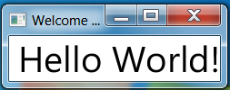


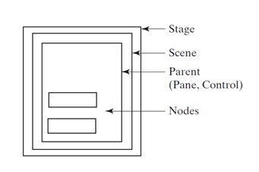
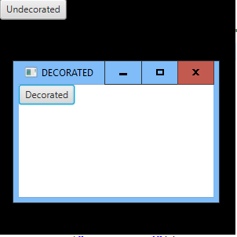
Stage
Stage je najvrchnejší kontainer, teda okno v rámci OS.
Group root = new Group(new Button("Undecorated"));
Scene scene = new Scene(root, 300, 300, Color.BLACK);
Stage newStage = new Stage(StageStyle.UNDECORATED);
newStage.setScene(scene);
newStage.setTitle("UNDECORATED");
newStage.show();
Group root = new Group(new Button("Decorated"));
Scene scene = new Scene(root);
Stage newStage = new Stage(StageStyle.DECORATED);
newStage.setScene(scene);
newStage.setTitle("DECORATED");
newStage.show();
.setTitle()
.setScene()
.sizeToScene()
.initStyle()
.initModality()
.show()
Súbor: MultiStageDemo.java

Slide 7
Scene
Scéna predstavuje vrchný element stromovej
štruktúry elementov typu Node, resp. Parent
Má konštruktory:
Scene(Parent root)
new Scene(root);
Scene(Parent root, double width, double height)
new Scene(root,400,400);
Scene(Parent root, double w, double h, Paint fill)
new Scene(root, 200, 200, Color.BLUE);
Parent má deti typu Node, presnejšie poskytuje metódu
ObservableList<Node> getChildren()
root.getChildren().addAll(node1, node2, …)
Parent
Control,
Group,
Region,
  Axis,
  Chart,
  Pane
    BorderPane,
    FlowPane,
    GridPane,
    HBox,
    StackPane,
    Vbox,
    ...

Slide 8
Štruktúra tried
Node
Canvas,
ImageView,
Parent,
MediaView,
Shape
  Circle,
  Ellipse,
  Line,
  Polygon,
  Polyline,
  Rectangle,
  Text
  ...
Control
ChoiceBox,
ComboBoxBase,
  ComboBox
Labeled,
  ButtonBase,
    Button,
    CheckBox,
    ToggleButton
  Label,
ListView,
TextInputControl,
  TextArea,
  TextField

Slide 9
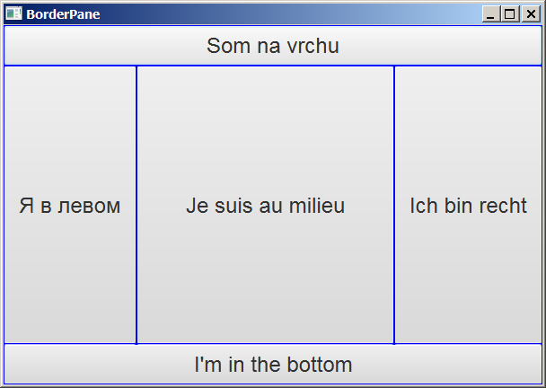
BorderPane
class MyButton extends Button {
public MyButton(String text) {
super(text);
setMaxWidth(Double.MAX_VALUE);
setMaxHeight(Double.MAX_VALUE);
setStyle("-fx-border-color: blue;
-fx-font: 24px 'Arial';");
} }
BorderPane root = new BorderPane();
root.setTop(new MyButton("Som na vrchu"));
root.setBottom(new MyButton("I'm in the bottom"));
root.setRight(new MyButton("Ich bin recht"));
root.setLeft(new MyButton("Я в левом"));
root.setCenter(new MyButton("Je suis au milieu"));
Scene scene = new Scene(root, 600, 400);
primaryStage.setScene(scene);
primaryStage.setTitle("BorderPane");
primaryStage.show();
Súbor: Layouts.java

Slide 10
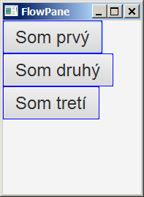
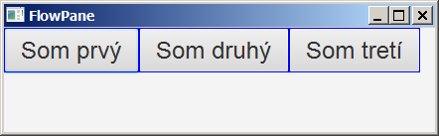
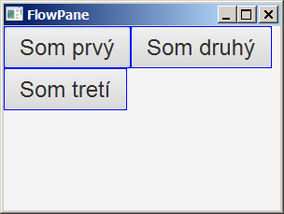
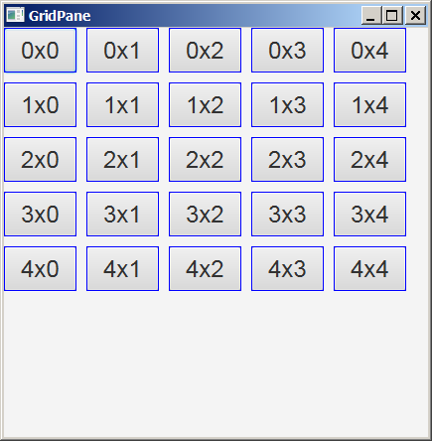
FlowPane, GridPane
FlowPane root = new FlowPane(
new MyButton("Som prvý"), new MyButton("Som druhý"),new MyButton("Som tretí"));
Scene scene = new Scene(root, 300, 400);
Stage newStage = new Stage();
newStage.setScene(scene);
newStage.setTitle("FlowPane");
newStage.show();
GridPane root = new GridPane();
for (int i = 0; i < 5; i++)
for (int j = 0; j < 5; j++)
root.add(new MyButton(i + "x" + j), j, i);
root.setHgap(10);
root.setVgap(10);
Scene scene = new Scene(root, 400, 400);
Stage newStage = new Stage();
newStage.setScene(scene);
newStage.setTitle("GridPane");
newStage.show(); }
Súbor: Layouts.java

Slide 11
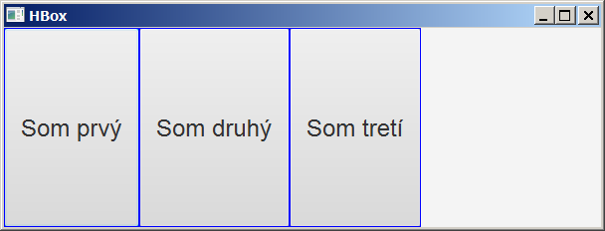
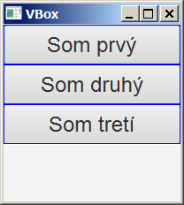
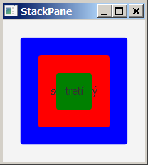
HBox, VBox, StackPane
HBox root = new HBox(
new MyButton("Som prvý"), new MyButton("Som druhý"), new MyButton("Som tretí"));
VBox root = new VBox(
new MyButton("Som prvý"), new MyButton("Som druhý"), new MyButton("Som tretí"));
Button btn1 = new Button("naozaj som prvý");
btn1.setPrefSize(150,150);
btn1.setStyle("-fx-background-color: blue");
Button btn2 = new Button("som druhý");
btn2.setPrefSize(100,100);
btn2.setStyle("-fx-background-color: red");
Button btn3 = new Button("tretí");
btn3.setPrefSize(50,50);
btn3.setStyle("-fx-background-color: green");
StackPane root = new StackPane(btn1, btn2, btn3);
Súbor: Layouts.java

Slide 12
EventHandler
class MyButton extends Button {
setOnAction(new EventHandler<ActionEvent>() {
@Override
public void handle(ActionEvent event) {
System.out.println("stlačil si " + text);
}
});
setOnAction(event -> {
System.out.println("stlačil si " + text);
});
setOnMouseClicked(event -> {
System.out.println("klikol si " + text + ", " +
event.getX() + ", " + event.getY());
});
setOnKeyPressed(event -> {
System.out.println("stlačil si " + text + ", " + event.getCode());
});
Súbor: Layouts.java

Slide 13
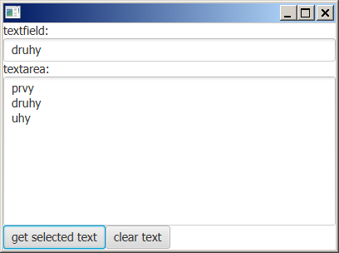
TextField, TextArea
Button b1 = new Button(“get selected text");
Button b2 = new Button("clear text");
TextField tf = new TextField(); tf.setPrefWidth(100);
TextArea ta = new TextArea(); ta.setPrefWidth(100);
ta.setEditable(false);
b1.setOnAction(event -> {
ta.setText(ta.getSelectedText());});
b2.setOnAction(event -> {
ta.clear(); });
tf.setOnAction(event -> {
ta.appendText(tf.getText() + "\n");});
VBox fp = new VBox(
new Label("textfield:"), tf,
new Label("textarea:"), ta,
new FlowPane(b1, b2));
Súbor: TextFieldDemo.java

Slide 14
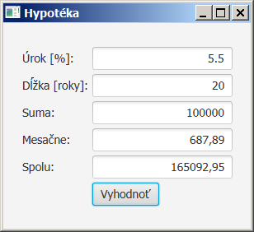
Malá kalkulačka
public class Hypoteka extends Application {
TextField tfUrokovaMiera = new TextField(),
tfPocetRokov = new TextField(),
tfSuma = new TextField(),
tfMesacneSplatky = new TextField(),
tfSpolu = new TextField();
Button btVypocet = new Button("Vyhodnoť");
GridPane gridPane = new GridPane();
gridPane.setHgap(5);
gridPane.setVgap(5);
gridPane.add(new Label("Úrok [%]:"),0,0);
gridPane.add(tfUrokovaMiera, 1, 0);
gridPane.add(new Label("Dĺžka [roky]:"),0,1);
gridPane.add(tfPocetRokov, 1, 1);
gridPane.add(new Label("Suma:"),0,2);
gridPane.add(tfSuma, 1, 2);
gridPane.add(new Label("Mesačne:"),0,3);
gridPane.add(tfMesacneSplatky, 1,3);
gridPane.add(new Label("Spolu:"),0,4);
gridPane.add(tfSpolu, 1, 4);
gridPane.add(btVypocet, 1, 5);
tfUrokovaMiera.setAlignment(Pos.BOTTOM_RIGHT);
tfPocetRokov.setAlignment(Pos.BOTTOM_RIGHT);
tfSuma.setAlignment(Pos.BOTTOM_RIGHT);
tfMesacneSplatky.setAlignment(Pos.BOTTOM_RIGHT);
tfSpolu.setAlignment(Pos.BOTTOM_RIGHT);
tfMesacneSplatky.setEditable(false);
tfSpolu.setEditable(false);
btVypocet.setOnAction(e -> {
rocnyUrok = Double.parseDouble(
tfUrokovaMiera.getText());
pocetRokov = Integer.parseInt(
tfPocetRokov.getText());
suma = Double.parseDouble(
tfSuma.getText());
tfMesacneSplatky.setText(
String.format("%.2f", mesacneSplatky()));
tfSpolu.setText(
String.format("%.2f", getTotalPayment()));
});
Súbor: Hypoteka.java

Slide 15

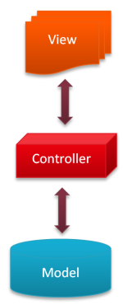
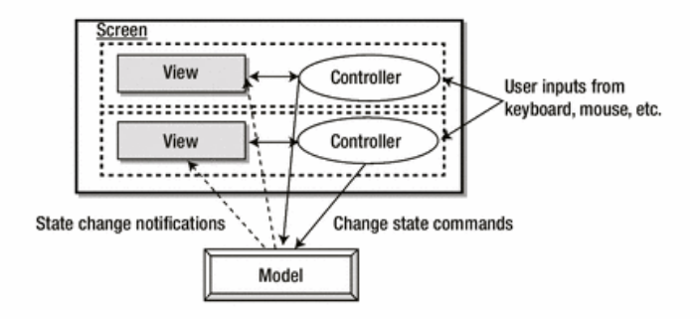
IDE IntelliJ
ďalšia možnosť ako vytvoriť stand-alone/webstart/web aplikáciu
podporuje tvorbu JavaFX aplikácií (New/JavaFX/JavaFX Application)
aj FXML aplikácií (New/JavaFX/JavaFX FXML Application)
podporuje Model-View-Controller (MVC) prostredníctvom FXML
  View: prezentačná úroveň, vizuálne komponenty (Controls), layouts (Containers) , útvary (Shapes), štýly…
  Controller: logika, väzba medzi View a Modelom,
  Model: data, reprezentácia

Slide 16
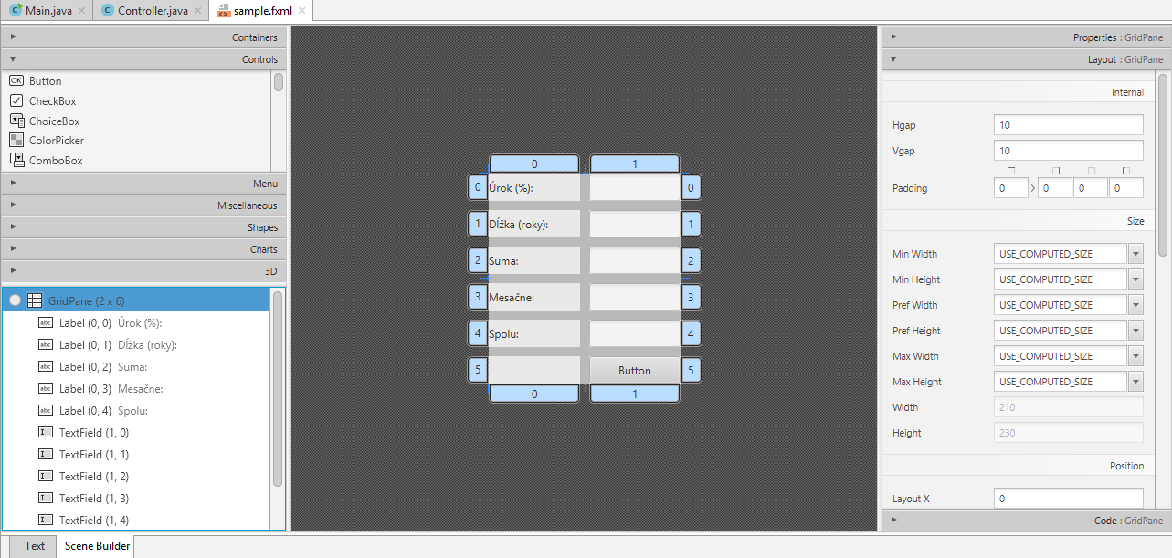
FXML
SceneBuilder – IntelliJ, Eclispe

Slide 17
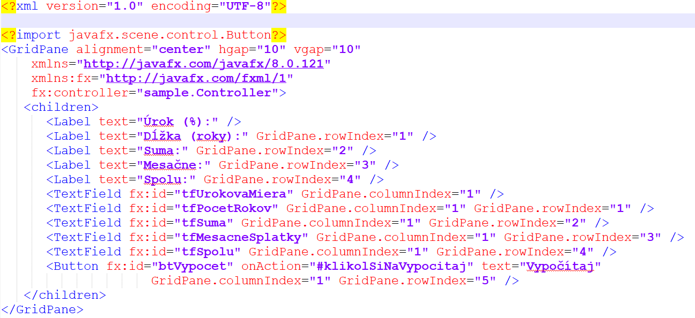

FXML
SceneBuilder – IntelliJ, Eclispe

Slide 18
Controller
public class Controller {
@FXML
private TextField tfUrokovaMiera;
@FXML
private TextField tfPocetRokov;
@FXML
private TextField tfSuma;
@FXML
private TextField tfMesacneSplatky;
@FXML
private TextField tfSpolu;
@FXML
private Button btVypocet;
public void klikolSiNaVypocitaj(ActionEvent event) {
double rocnyUrok = Double.parseDouble(tfUrokovaMiera.getText());
double pocetRokov = Integer.parseInt(tfPocetRokov.getText());
double suma = Double.parseDouble(tfSuma.getText());
double mesacnyUrok = rocnyUrok/12/100;
double mesacneSplatky =
suma*mesacnyUrok/(1-(1/Math.pow(1+mesacnyUrok, pocetRokov*12)));
tfMesacneSplatky.setText(String.format("%.2f", mesacneSplatky));
double getTotalPayment = mesacneSplatky * pocetRokov * 12;
tfSpolu.setText(String.format("%.2f", getTotalPayment));
}
}

Slide 19
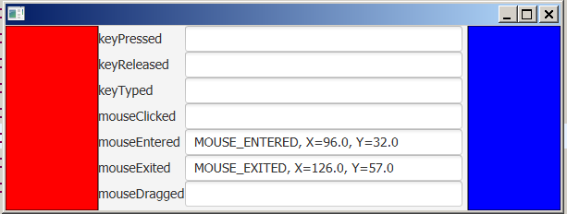
MouseEvent, KeyEvent
Hashtable<String, Node> h = new Hashtable<String, Node>();
String[] event = { "keyPressed", "keyReleased", "keyTyped",
"mouseClicked", "mouseEntered", "mouseExited", "mouseDragged"};
SmallPane bluePane = new SmallPane(this, Color.BLUE),
redPane = new SmallPane(this, Color.RED);
GridPane gp = new GridPane();
for (int i = 0; i < event.length; i++) {
TextField t = new TextField();
t.setPrefWidth(300); t.setEditable(false);
gp.add(new Label(event[i]), 0, i);
gp.add(t, 1, i);
h.put(event[i], t);
}
BorderPane bp = new BorderPane();
bp.setCenter(gp);
bp.setRight(bluePane);
bp.setLeft(redPane);
Scene scene = new Scene(bp, 600, 200);
Súbor: MouseKeyEvent.java

Slide 20
Pokračovanie
Event
ActionEvent,
InputEvent,
  DragEvent
  KeyEvent,
  MouseEvent,
  TouchEvent
  ...
WindowEvent,
...
class SmallPane extends Pane {
SmallPane(AutoEvent parent, Color color) {
this.parent = parent;
this.color = color;
setPrefWidth(100);
setFocusTraversable(true);
setOnKeyPressed(event -> {
TextField t = (TextField) parent.h.get("keyPressed");
t.setText(event.getEventType() + ", keyCode="+ event.getCode());
paint();
event.consume();
} );
setOnMouseClicked(event -> {
TextField t = (TextField) parent.h.get("mouseClicked");
t.setText(event.getEventType() + ", X="+ event.getX() + ", Y="+ event.getY());
paint();
event.consume();
} );
Súbor: MouseKeyEvent.java

Slide 21
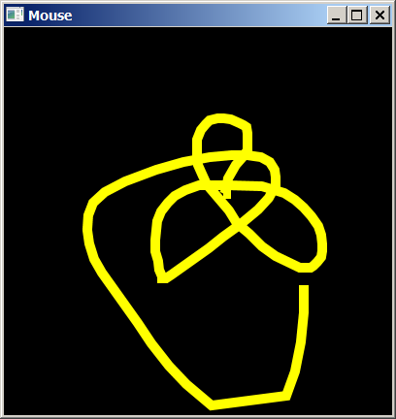
Polyline, Polygon
MousePane p = new MousePane();
Scene scene = new Scene(p, 400, 400, Color.BLACK);
scene.setOnMouseMoved(event -> {
if (listOfPositions.size() >= 200) {
listOfPositions.removeElementAt(0);
listOfPositions.removeElementAt(1);
}
listOfPositions.addElement(
event.getX());
listOfPositions.addElement(
event.getY());
p.paint();
event.consume();
} );
class MousePane extends Pane {
public void paint() {
getChildren().clear();
Double[] d =
listOfPositions.toArray(new Double[]{});
Polyline pl = new Polyline();
pl.setStroke(Color.YELLOW);
pl.setStrokeWidth(10);
pl.getPoints().addAll(d);
getChildren().add(pl);
}
}
Súbor: MouseDemo.java

Slide 22
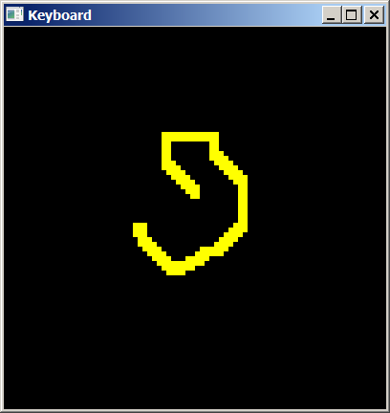
Pomocou šípiek
MousePane p = new MousePane();
Scene scene = new Scene(p, 400, 400, Color.BLACK);
scene.setOnKeyPressed(event -> {
if (listOfPositions.size() >= 200) {
listOfPositions.removeElementAt(0);
listOfPositions.removeElementAt(0);
}
if (event.getCode() == KeyCode.UP) y -= 5;
if (event.getCode() == KeyCode.DOWN) y += 5;
if (event.getCode() == KeyCode.LEFT) x -= 5;
if (event.getCode() == KeyCode.RIGHT) x += 5;
listOfPositions.addElement(x);
listOfPositions.addElement(y);
p.paint();
event.consume();
} );
Súbor: KeyDemo.java

Slide 23
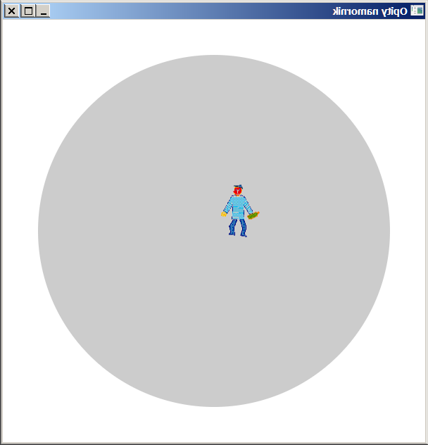
Canvas
public void paintCanvas() {
GraphicsContext gc = getGraphicsContext2D();// kreslenie do canvasu
gc.clearRect(0, 0, sizeX, sizeY);
gc.setFill(Color.gray(0, 0.2));
gc.fillOval(centerX - scale * moloSize, centerY - scale * moloSize,
scale * 2 * moloSize, scale * 2 * moloSize);
if (namornik.alive) { // ak sa este neutopil, nakresli obrazok namornika
gc.drawImage(new Image("namornik.gif"), // namornik.img,
namornik.getXPixel(false),
namornik.getYPixel(false));
} else { // ak je utopeny, nakresli vlny zobraz v strede vln pocet krokov
gc.setStroke(Color.RED);
gc.strokeText(Integer.toString(namornik.nsteps),
namornik.getXPixel(true) - 8,
namornik.getYPixel(true) + 7);
Súbor: NamornikAppFx.java

Slide 24
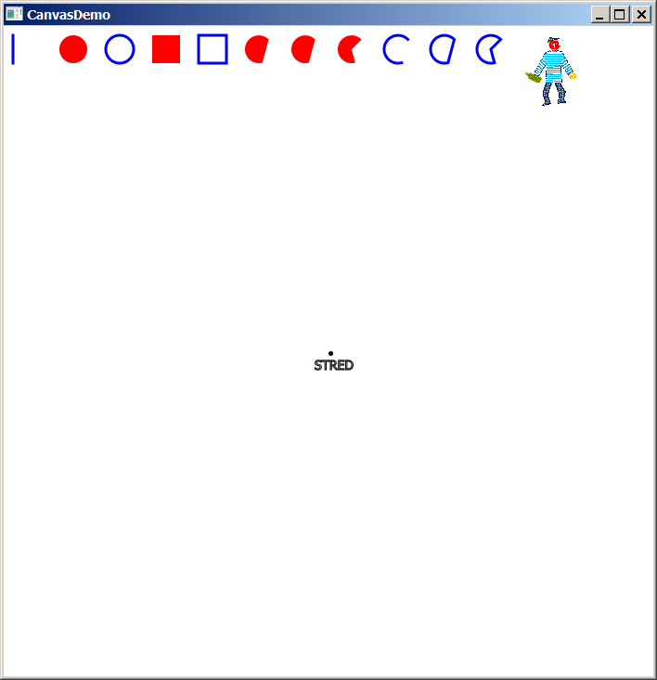
Kreslenie do Canvas
Canvas canvas = new Canvas(700, 700);
GraphicsContext gc = canvas.getGraphicsContext2D();
gc.fillOval(350, 350, 5, 5);
gc.strokeText("STRED", 335, 370);
.setFill(Color.RED);
.setStroke(Color.BLUE);
.setLineWidth(3);
.strokeLine(x, y, x, y + 30);
.fillOval(x += 50, y, 30, 30);
.strokeOval(x += 50, y, 30, 30);
.fillRect(x += 50, y, 30, 30);
.strokeRect(x += 50, y, 30, 30);
.fillArc(x += 50, y, 30, 30, 45, 240, ArcType.OPEN);
.strokeArc(x += 50, y, 30, 30, 45, 240, ArcType.OPEN);
.drawImage(new Image("namornik.gif"), x += 50, y);
Súbor: CanvasDemo.java

Slide 25
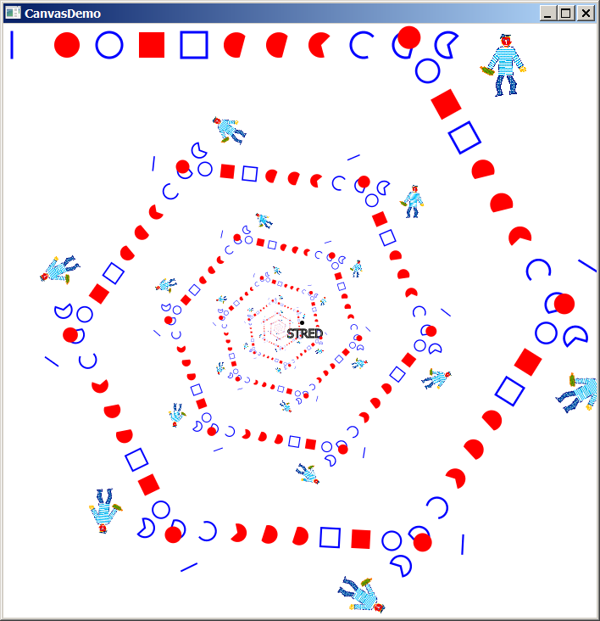
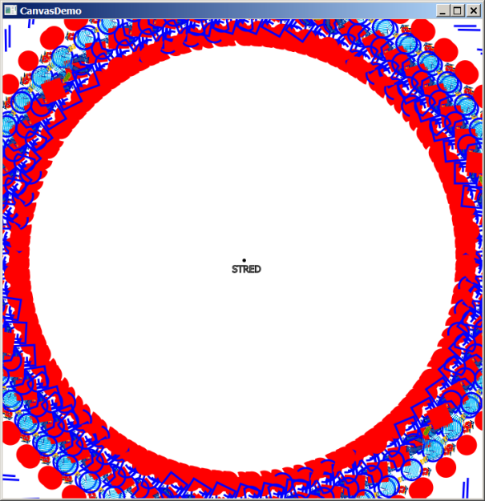
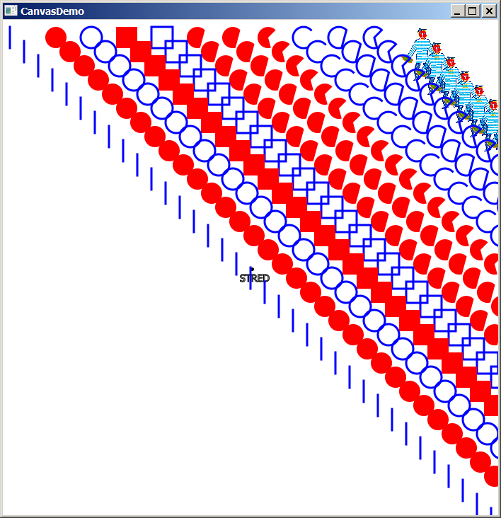
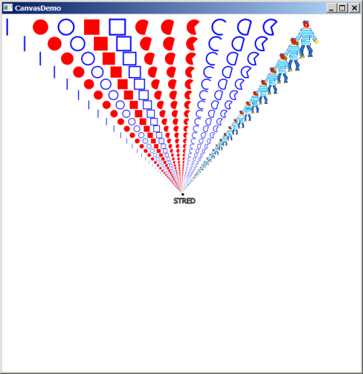
Afinné zobrazenia
Z lineárnej algebry:
otočenie o uhol α okolo stredu x,y,
posunutie dx,dy
rovnoľahlosť/natiahnutie kx,ky podľa stredu x,y
Affine af = new Affine(); // afinné zobrazenie
for (int i = 0; i < 100; i++) {
af.append(Affine.scale(0.9, 0.9, 350, 350)); // rovnoľahlosť
af.append(Affine.rotate(60, 350, 350)); // otočenie
af.append(Affine.translate(20, 20)); // posunutie
gc.setTransform(af);
paintShapes(gc);
}
Súbor: CanvasDemo.java

Slide 26
Philozophers

Slide 27
Hracia plocha
hracia plocha je často šachovnica rôznych rozmerov. Ako ju implementujeme:
jeden veľký canvas/Pane-l
  musíme riešiť transformáciu pixelových súradníc do súradníc hracej plochy:
  a naopak, v metóde paint/paintComponent [i,j] -> [x, y]
grid canvasov/Pane-lov:
  každý canvas/panel má svoje súradnice od [0,0]
  každý canvas/panel má svoj mouse lhandler
  každý canvas panel má svoju metódu paint/paintComponent
  veľkosť gridu upravíme podľa veľkosti obrázkov,
  resp. veľkosť obrázku upravíme podľa veľkosti panelu
grid buttonov/Button-ov:
[e.x,e.y]->[1,1]

Slide 28
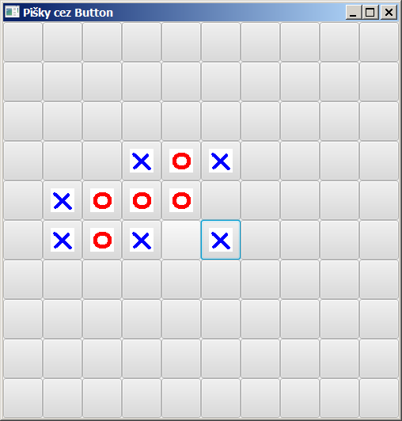
Riešenie Grid/Button
class PiskyState implements Serializable {
public int[][] playground = new int[SIZE][SIZE];
public boolean nextPlayerIsX = false;
public long elapsedTime = 0;
}
class Piskyground extends GridPane {
public Piskyground() {
for (int i = 0; i < PiskvorkyGridButton.SIZE; i++)
for (int j = 0; j < PiskvorkyGridButton.SIZE; j++)
add(new PiskyCell(i, j), j, i);
} }
Súbor: PiskvorkyGridButton.java

Slide 29
Riešenie Grid/Button
class PiskyCell extends Button {
int i, j;
public PiskyCell(int i, int j) {
this.i = i;
this.j = j;
setPrefSize(50, 50);
setOnAction(event -> {
if (ps.playground[i][j] != 0) return;
if (ps.nextPlayerIsX) {
ps.playground[i][j] = 1;
setGraphic(new ImageView(new Image("x.gif")));
} else {
ps.playground[i][j] = -1;
setGraphic(new ImageView(new Image("o.gif")));
}
ps.nextPlayerIsX = !ps.nextPlayerIsX;
} );
} }
Súbor: PiskvorkyGridButton.java

Slide 30
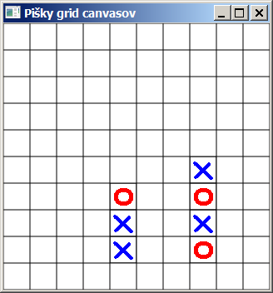
Riešenie Grid/Canvas
class PiskyCell extends Canvas {
int i, j;
public PiskyCell(int i, int j) {
this.i = i; this.j = j;
setWidth(imageX.getWidth()+2);
setHeight(imageX.getHeight()+2);
setOnMouseClicked(event -> {
if (ps.playground[i][j] != 0) return;
ps.playground[i][j] = (ps.nextPlayerIsX)?1:-1; paintCell();
ps.nextPlayerIsX = !ps.nextPlayerIsX;
});
}
public void paintCell() {
GraphicsContext gc = getGraphicsContext2D();
gc.strokeRect(0, 0, getWidth(), getHeight());
if (ps.playground[i][j] == 1) gc.drawImage(new Image("x.gif"), 1, 1);
else if (ps.playground[i][j] == -1) gc.drawImage(new Image("o.gif"), 1,1);
} }
Súbor: PiskvorkyGridCanvas.java

Slide 31
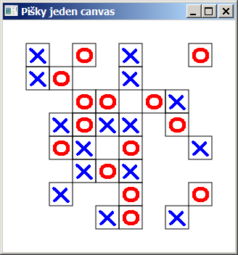
Riešenie Canvas
class Piskyground extends Canvas {
Image imageX = new Image("o.gif");
Image imageO = new Image("x.gif");
double cellSize = 2+Math.max(
Math.max(imageX.getWidth(), imageO.getWidth()),
Math.max(imageX.getHeight(), imageO.getHeight()));
public Piskyground() {
setWidth(SIZE * (imageX.getWidth() + 2));
setHeight(SIZE * (imageX.getHeight() + 2));
setOnMouseClicked(event -> {
int i = getRow(event.getX());
int j = getCol(event.getY());
if (ps.playground[i][j] != 0) return;
ps.playground[i][j] = (ps.nextPlayerIsX) ? 1 : -1;
paintCell(i, j);
ps.nextPlayerIsX = !ps.nextPlayerIsX;
} );
}
Súbor: PiskvorkyCanvas.java

Slide 32
Riešenie Canvas
class Piskyground extends Canvas {
public void paintCell(int i, int j) {
double px = getPixelX(i);
double py = getPixelY(j);
GraphicsContext gc = getGraphicsContext2D();
gc.strokeRect(px, py, cellSize, cellSize);
if (ps.playground[i][j] == 1) gc.drawImage(imageX, px+1, py+1);
else if (ps.playground[i][j] == -1) gc.drawImage(imageO, px+1, py+1);
}
private int getRow(double pixel) { === private int getCol(double pixel) {
return (int)(pixel/cellSize);
}
private double getPixelX(int i) { === private double getPixelY(int i) {
return i*cellSize;
}
Súbor: PiskvorkyCanvas.java

